Slide 1



BANKCRUPTCY PREVENTION PROJECT
Topic:
CLASSIFICATION

Slide 2



GROUP:6
Meghana
Sai krishna
Sanjana
Yessasvini
Abhishek Uttam Chaudary
Reshma

Slide 3

Business objective:
The fundamental goal here is to model the probability that a business goes bankrupt.
To predict the likelihood of a company going bankrupt based on the provided features: industrial risk, management risk, financial flexibility, creditability, competitiveness & operating risk.
Data-driven insights can help identify early warning signs &provide guidance for strategic decision-making.

Slide 4
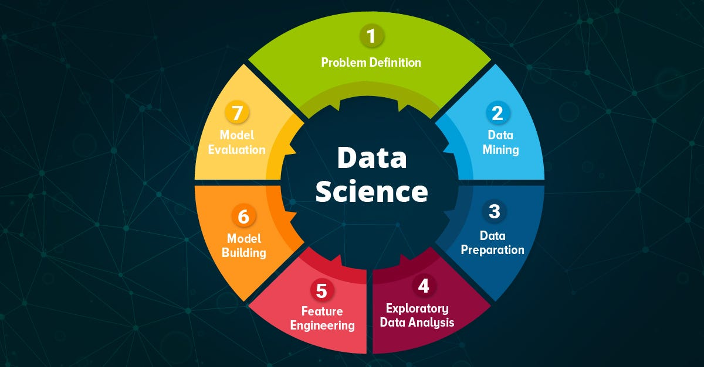
Project Architecture &Project Flow:
Step by step process:
Problem Statement
Data Preprocessing
Exploratory Data Analysis
(EDA)
Feature Engineering
Model Building
Deployment &Model Evaluation

Slide 5

Data Set Information:
The data set contains 7 columns about 250 rows:
Industrial risk: 0=low risk, 0.5=medium risk, 1=high risk.
Management risk: 0=low risk, 0.5=medium risk, 1=high risk.
financial flexibility: 0=low flexibility, 0.5=medium flexibility, 1=high flexibility.
credibility: 0=low credibility, 0.5=medium credibility, 1=high credibility.
.competitiveness: 0=low competitiveness, 0.5=medium competitiveness,
1=high competitiveness.
Operating risk: 0=low risk, 0.5=medium risk, 1=high risk.
class: bankruptcy, non-bankruptcy (target variable).

Slide 6

EDA(Exploratory Data Analysis)
Exploratory Data Analysis(EDA) is an approach that is used to analyze the data and discover patterns ,or check assumptions in data with the help of statistical summaries and graphical representations; it can also help determine if the statistical techniques you are considering for data analysis are appropriate.

Slide 7
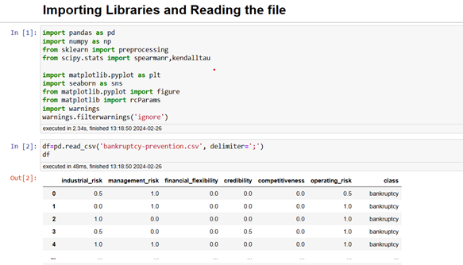
CONTENTS
AGENDA
Step1: Importing libraries and Reading file:
1.Importing Libraries and Reading File
2.Checking for Missing values
3.Checking for Correlation
4.pandas.Crosstab
5.Distribution Plot
6.Violin and Strip Plot
7.Line Plot
8.Histogram plots
9.Density Estimate Plots
10.Grouped Bar Charts using sns.catplot
11.Stacked Bar Charts
12.Conclution

Slide 8
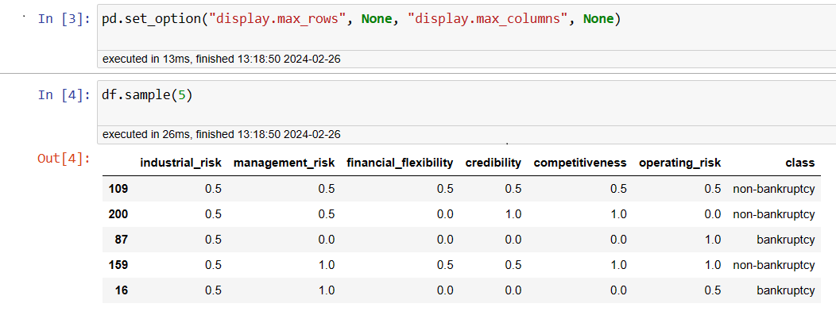
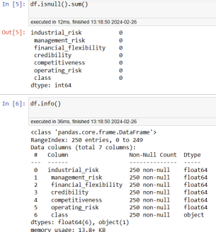
Dataset with top5 rows:
Checking for null values:

Slide 9
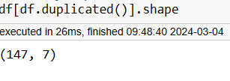
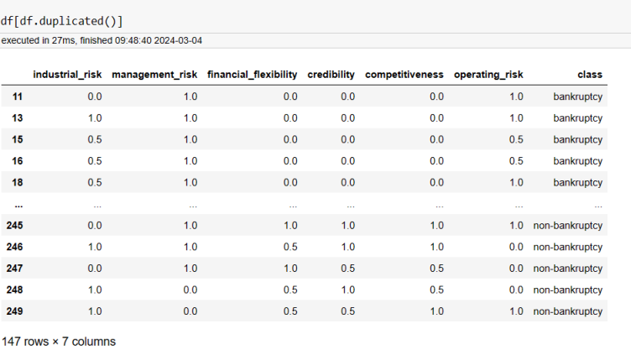
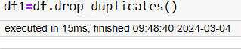
Checking duplicate values :
Count of duplicated rows:
We have 147 rows and 7 columns count,
Drop duplicates:

Slide 10
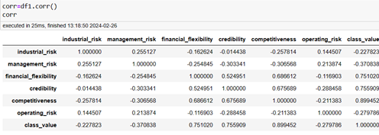
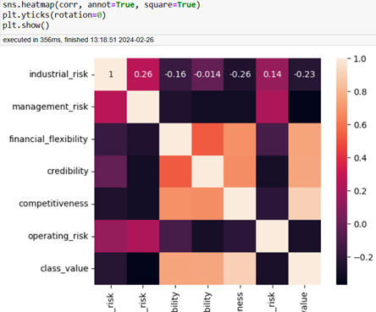
Checking for Correlation:
OBSERVATION:
Correlation of Heatmap:
The Correlation values between most variables are not high and so its confusing to find the importance of variables in predicting classes.

Slide 11
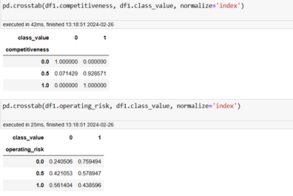
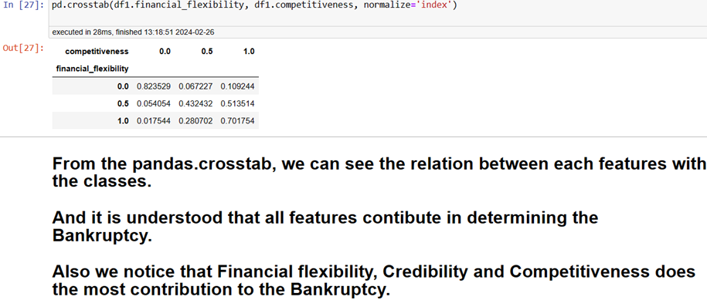
Using Crosstab: We now use Crosstab from pandas to understand each feature with respect to Bankruptcy.
OBSERVATION:
We notice that financial flexibility, credibility and competitiveness does the most contribution to the Bankruptcy.

Slide 12
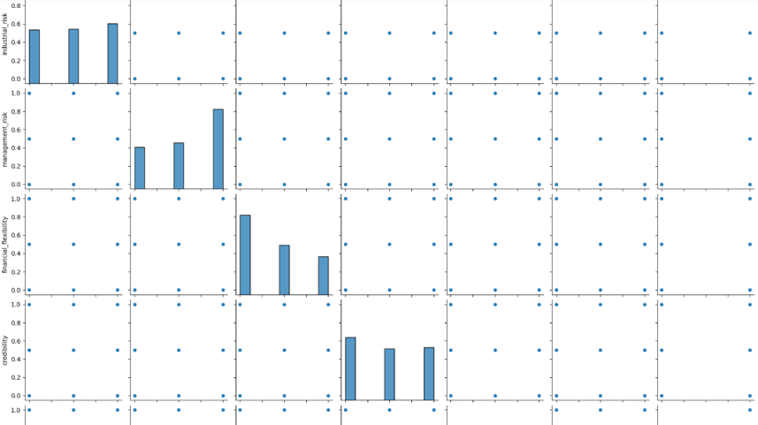
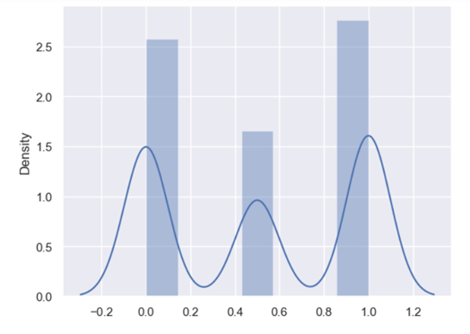
Pairplot: Pairplot for this data has proven to be not useful because the data is not continuous. Lets explore a bit more on sns.
Distribution Plot:
Distribution of Dataset is understood through this plot

Slide 13
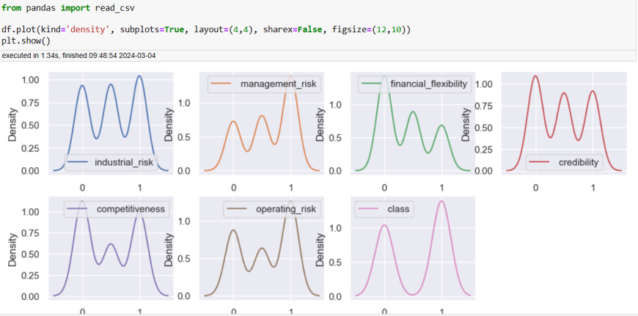
Density Plots:
OBSERVATION:
We use density plots understand the distribution of dataset.
We can understand the curve and shape of the plots

Slide 14
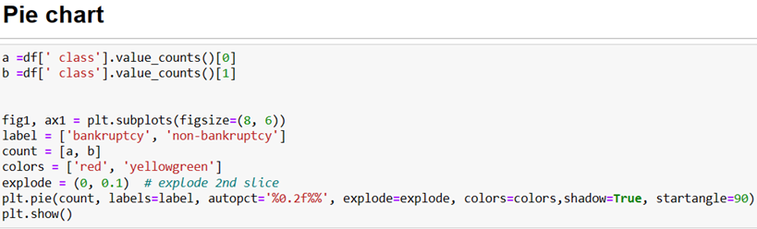
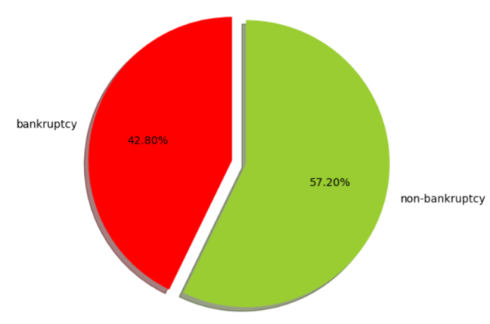
Pie chart:
Once we replace values with the actual data pie charts shows distribution of bankruptcy & non-bankruptcy classes.
OBSERVATION:
Bankcruptcy-42.8%
Non-Bankcruptcy-57.2%

Slide 15
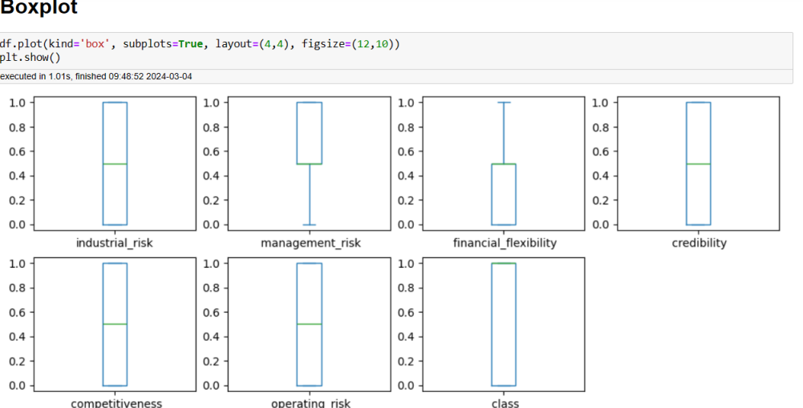
Box Plot:
We use box plot and create a sample data frame and replace with your actual data frame to generate
it with subplots one for each features.
OBSERVATION:

Slide 16
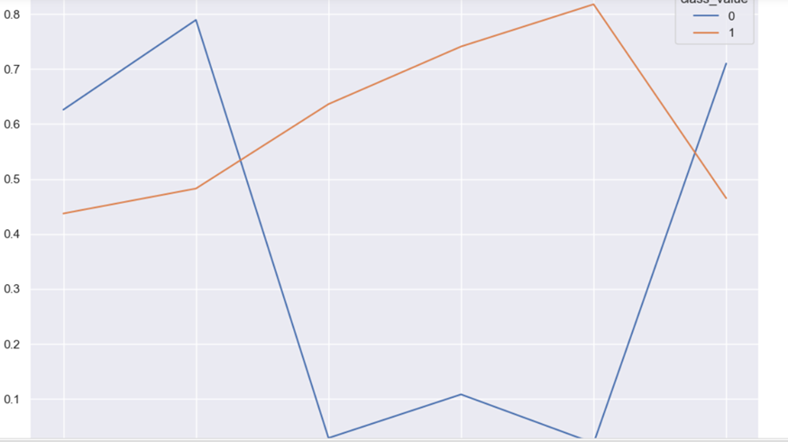
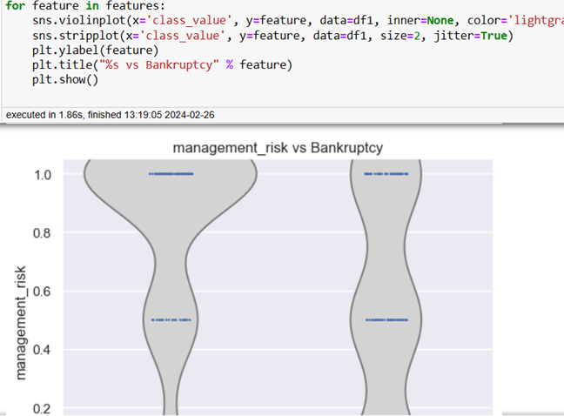
Understanding with Line plot:
The above line graph analyzes the mean of feature values based on the 2 classes of bankruptcy.
You can see which features affect bankruptcy in what way.
eg. From the given dataset, competitiveness gives bankrupt when its value is low and does not bankrupt when its values is high.
# From above all violineplot & stripplot we can understand three feature(Financial Flexibility , Credibility and Competitiveness) are highly correlated with dependent variable.
Viollin and Strip Plot:

Slide 17
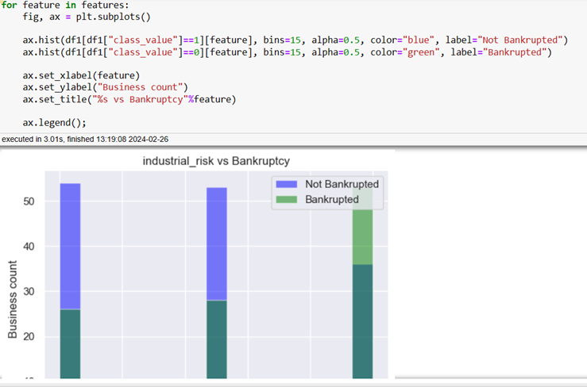
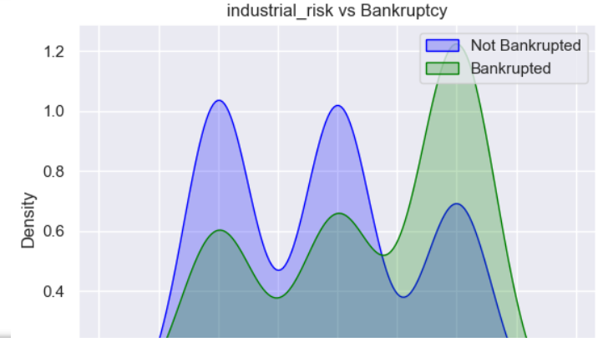
Histogram plots:
The below histogram graphs tells us the relation between each feature and the count of business with bankruptcy
OBSERVATIONS:
The above graphs show the density of Bankruptcy happening w.r.t different features. We can understand the spread of data with this graph i.e. Normal distribution.
Also we can know from the peaks of a Density Plot where values are concentrated over the interval.
We can also understand the distribution shape from the above plots.
Density Plots:

Slide 18
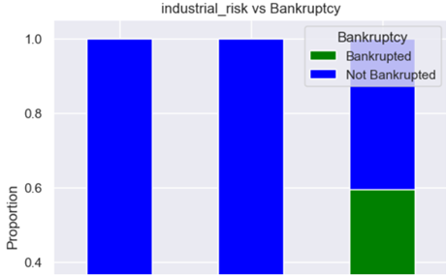
Stacked Bar Charts for Checking Proportions:
CONCLUSION FROM EDA PROCESS:
From the basic pd.crosstab executions, we find that Financial Flexibility, Competitiveness and Credibility does the most contribution for the bankruptcy.
From the Histograms, we can assume that Industrial Risk, Management Risk and Operating Risk have varied businesses(count) with varied Bankruptcy classes. These 3 feature surely impact a little for determining Bankruptcy.
The Density Estimate plots give the distribution shape which is Normally Distributed.
The grouped Bar charts(1&2) gives us the relation between features and Bankruptcy. We can declare Financial Flexibility, Competitiveness and Credibility are showing higher contribution to Bankruptcy.
We can also assume that Industrial Risk, Management Risk and Operating Risk have some impact in determining Bankruptcy. Its still Unclear.

Slide 19
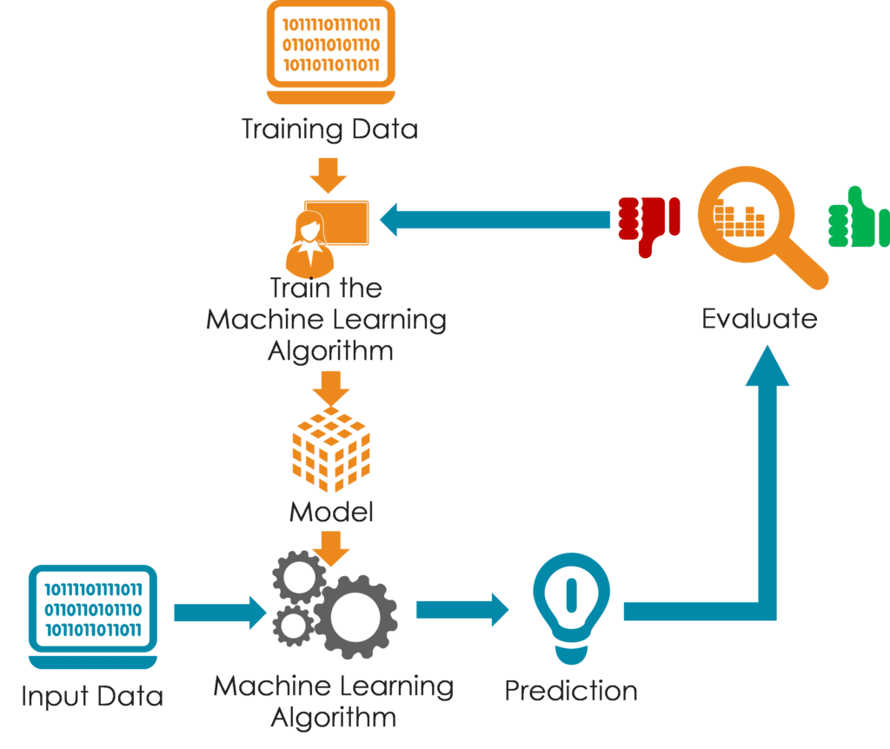
Model Building
We Fitted Machine Learning Models to the data given below:
Logistic Regression Model
Decision Tree Model
K Neighbours Classifier
Random Forest Classifier
Bagging Classifier
AdaBoost Classifier
Gradient Boost
SVC Linear Kernal
SVC polynomial Kernal
Stacking Classifier
Step By Step Process:

Slide 20
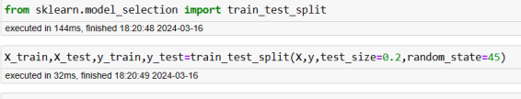
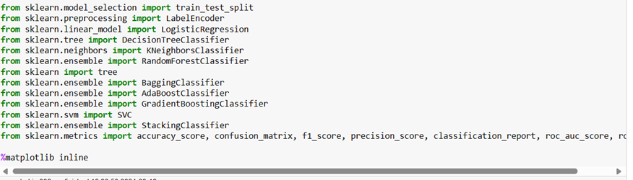
Training and Testing the models:
Split your dataset into training and testing subsets. Train the model on the training data and evaluate its performance on the testing data. Metrics like accuracy, precision, recall, and F1-score help assess model effectiveness
Train and Test Model:
Import Libraries:

Slide 21
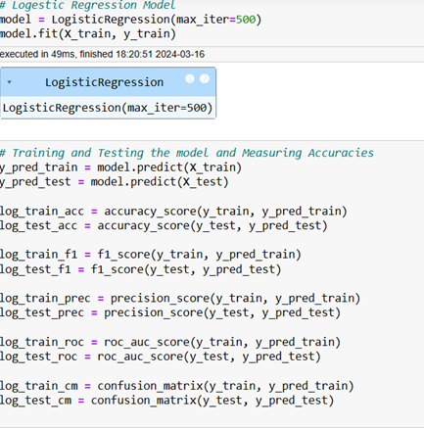
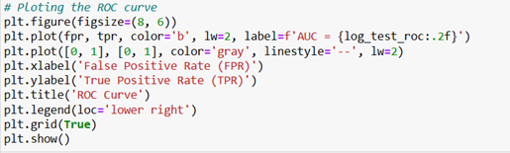
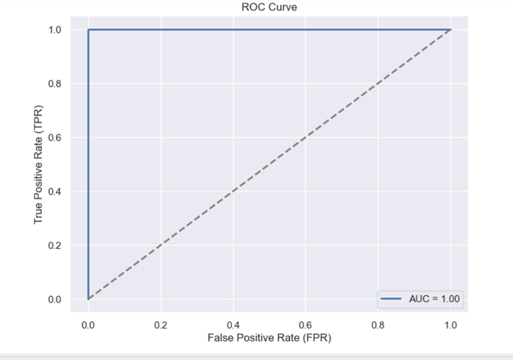
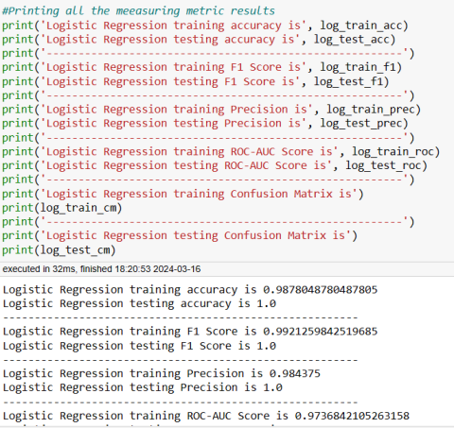
Logistic Regression
Calculating the ROC Curve:
Result: Logistic Regression training ROC-AUC Score is 0.9736842105263158
Logistic Regression testing ROC-AUC Score is 1.0

Slide 22
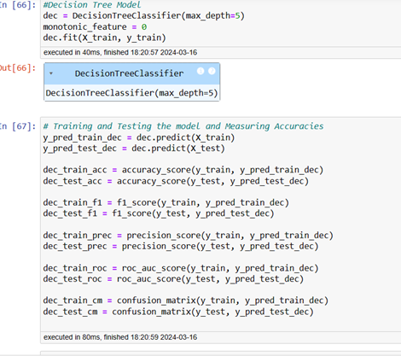
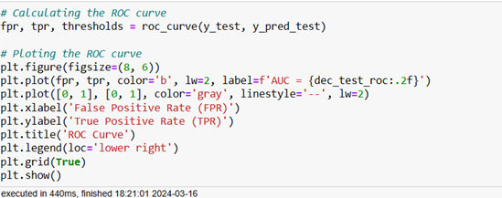
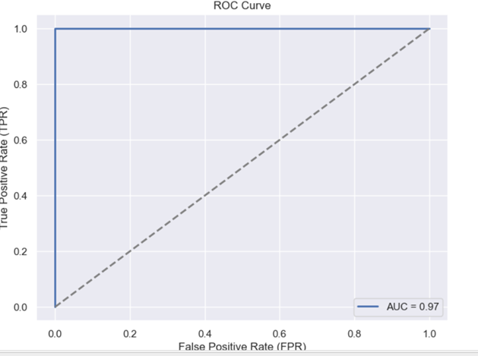
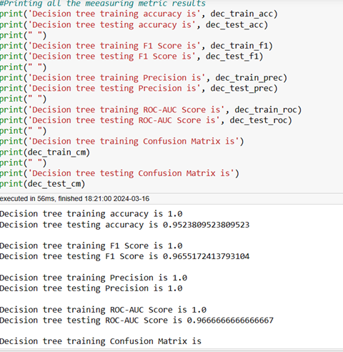
Decision Tree Model
Result:
Decision tree training ROC-AUC Score is 1.0
Decision tree testing ROC-AUC Score is 0.9666666666666667
Calculating ROC Curve:

Slide 23
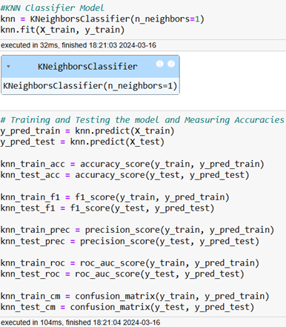
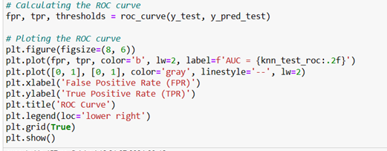
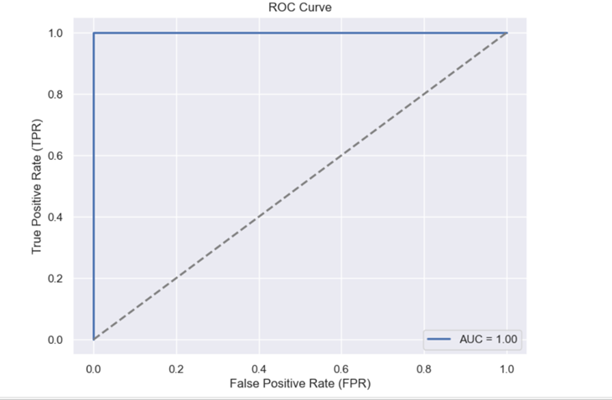
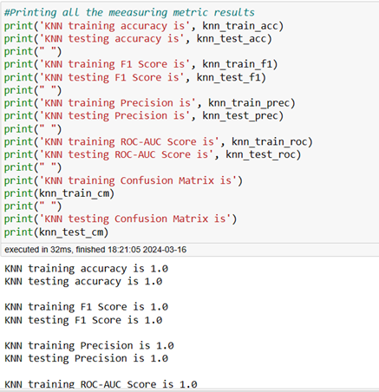
KNN Classifier Model
Calculating ROC Curve :
Result:
KNN training ROC-AUC Score is 1.0
KNN testing ROC-AUC Score is 1.0

Slide 24
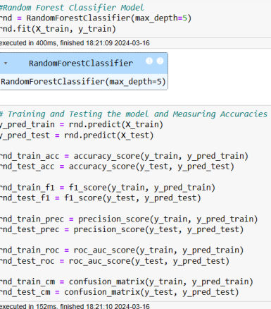
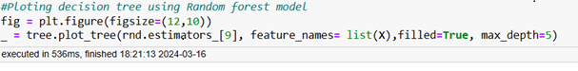
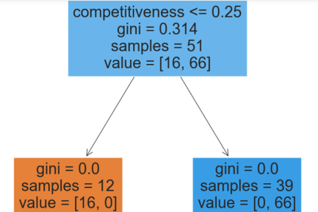
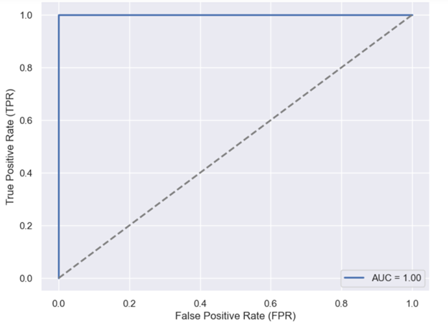
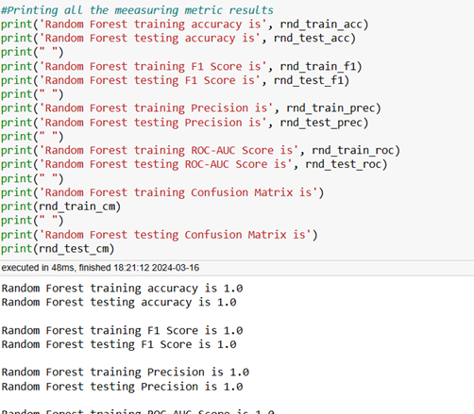
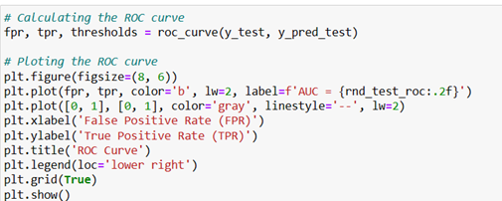
Random Forest Classifier
Result:
Random Forest training ROC-AUC Score is 1.0
Random Forest testing ROC-AUC Score is 1.0
Calculate ROC Curve:

Slide 25
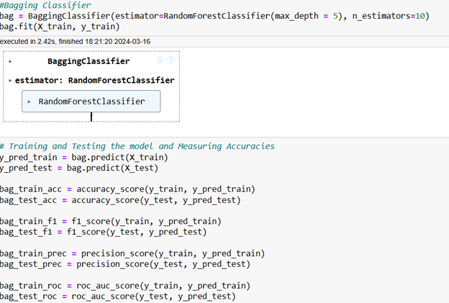
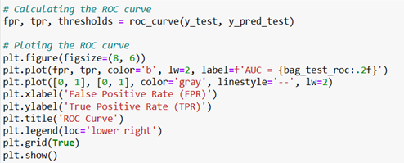
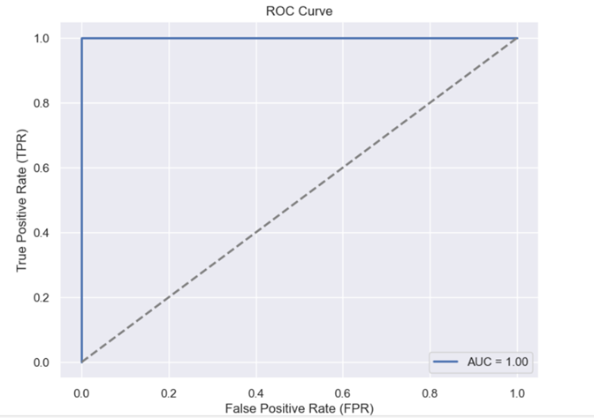
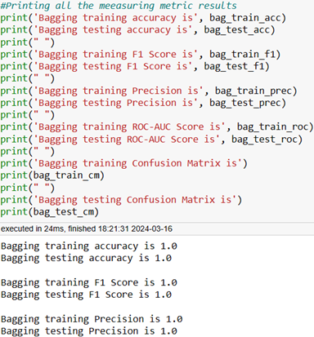
Bagging Classifier
Calculating ROC Curve:
Result:
Bagging training ROC-AUC Score is 1.0
Bagging testing ROC-AUC Score is 1.0

Slide 26
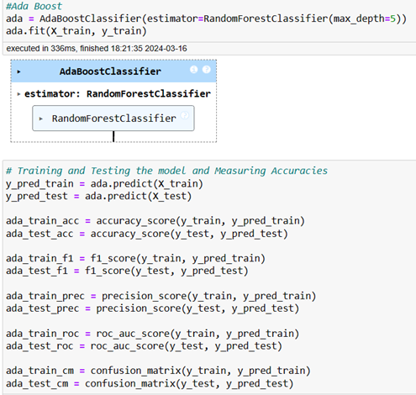
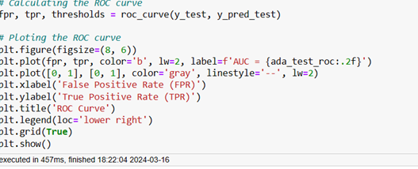
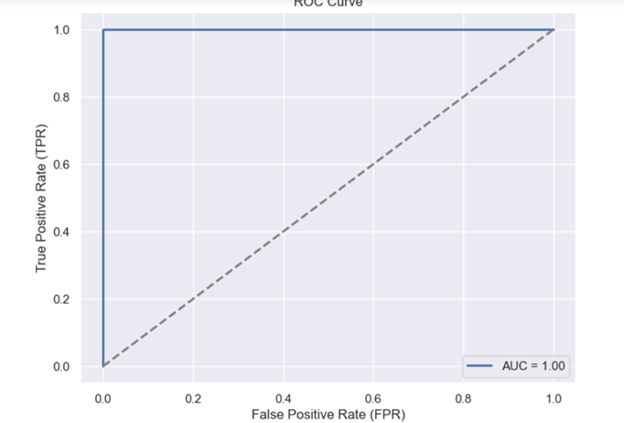

Ada Boost Classifier
Calculating ROC Curve:
Result:
AdaBoost training ROC-AUC Score is 1.0
AdaBoost testing ROC-AUC Score is 1.0

Slide 27




Gradient Boosting Classifier
Calculating ROC Curve:
Result:
Gradient Boost training ROC-AUC Score is 1.0
Gradient Boost testing ROC-AUC Score is 0.9666666666666667

Slide 28




SVC – Kernal Linear
Calculating ROC Curve:
Result:
SVC Linear Kernel training ROC-AUC Score is 0.9736842105263158
SVC Linear Kernel testing ROC-AUC Score is 1.0

Slide 29




SVC-Kernal Poly
Calculate ROC Curve:
Result:
SVC Polynomial Kernel training ROC-AUC Score is 1.0
SVC Polynomial Kernel testing ROC-AUC Score is 1.0

Slide 30




SVC
Calculating ROC Curve:
Result:
SVC RBF Kernel training ROC-AUC Score is 1.0
SVC RBF Kernel testing ROC-AUC Score is 0.5

Slide 31





Stacking Classifier
Calculating ROC Curve:
Result:
Stacking training ROC-AUC Score is 1.0
Stacking testing ROC-AUC Score is 1.0

Slide 32

Final Model Evaluation
Results:
The project is about building a ML model to predict the probability that a business goes bankrupt by using different features. Employed various classification ML algorithms including Logistic Regression, SVM, and Random Forest and achieved accuracy rates consistently above 90% for all the models.
We observed Random forest Model is the best suitable one with accuracy of 100% for final better results.
Final Result: array([0, 0, 1, 1, 1, 1, 1, 1, 0, 1, 1, 1, 1, 1, 1, 0, 1, 0, 0, 1, 1])

Slide 33

Deployment
Result:
We imported necessary libraries for deployment process like pickle, dump, Streamlit.
Once we constructed the code for deployment process and also we adjusted some modifications arranging the BG Image.
Based on problem statement the data points which plays the bankruptcy or non-bankcruptcy for the each features
Importing Pickle file:
PKL file is an extension for a python module that stores python objects in binary format.
PKL files can be used to generate static configurations for tools configured with
JSON, YAML or other static configuration formats.

Slide 34



Deployment using Streamlit Result:
Result prediction for Non –Bnakcruptcy:
Result prediction for Bnakcruptcy:
Model deployed through Local host:8501.

Slide 35

This application helps stake holder to prevent their business from bankruptcy by checking through its early stages . User has to just input the values and our model immediately displays the prediction of bankruptcy (0) or non-bankruptcy (1).

Slide 36
Challenges faced while doing project &how did you overcome it.
1.The Variables were Categorical Variables
Solution: Applied Label encoding to convert categorical data in to numerical format.
2.Evaluation of Metrics, choosing appropriate evaluation metrics
Solution: Utilized methods like precession ,recall, F1-score , and ROC curve for comprehensive Model Evaluation.
3.Platform: Selection for Deployment
Solution: Deployed the model on Streamlit sharing for easy and free hosting

Slide 37


